Slide 1

Language Points

Slide 2
Para. 1 Introduction
As we walk the “path of life”, we may sometimes wish to be alone with our own thoughts, for quiet periods of reflection can lead to personal improvement. However, when we seek to be alone, we must be careful that we do not always escape into our own world. Social life is also important to us. More often than not, close friendships will help smooth out the sometimes rocky road that we are all meant to travel.
和...独处
反思
导致
(result in)
追求...
逃入...
通常
消除(问题)；使平坦
注定要做...

Slide 3
Para. 2 Hook
n.优点
As we live in social groups, there are many benefits of friendship that we can enjoy. Generally speaking, close friendships have three “fruits”: they may comfort the heart, advise the head and help us achieve the goals we set for ourselves. Through friendship, we can become happier, wiser and more satisfied humans.
通常来说
vt.安慰
实现目标
adj.感到满足的

Slide 4
Para. 3 Fruit 1 (peace)
The first fruit of friendship is the peace that comes from sharing with friends our joy, sadness, success and failure. Here, friendship has a double advantage—happiness takes on a greater meaning and a trouble shared becomes a trouble halved! Naturally, this kind of openness results from a close friendship.
承担
adv.当然
来自于

Slide 5
Para. 3 Fruit 1 (peace)
无拘束，自由
最大程度地
With true friends, we feel free to share our joy and sadness in full measure. We know that our friends will both respect our feelings and treasure these moments of closeness. Indeed, the human heart depends on such opportunities for comfort and protection.
尊重
时刻
的确
依赖于

Slide 6
Para. 4 Fruit 2 (better understanding & judgement)
The second fruit of friendship is the better understanding and judgement that may be achieved through conversations with well-meaning and wise friends. We often find it easier to recognize other people’s weaknesses than our own. As a result, if we are guided only by our own feelings, our judgements might be one-sided.
善意的
认清
因此
片面的

Slide 7
Para. 4 Fruit 2 (better understanding & judgement)
能够
On the other hand, our friends are better able to offer advice on important decisions that we all have to make. Also, when we want to talk our problems over with a friend, we have to put our thoughts into words first. This alone helps make our thoughts clearer and brings us a more thorough understanding of our problems.
n.决定
把我们的想法用
语言表达出来
全面的；彻底的

Slide 8
Para. 5 Fruit 3 (the help)
The third fruit of friendship is the help that a friend may offer in many different ways. Sometimes a friend is even known as our “second self”. There are so many things in life that can only be achieved with the help of friends. Friends may have many different ideas and skills. They can help us achieve what we want during life and, perhaps, even after death.
被称为...
在...的帮助下

Slide 9
Para. 6 Conclusion
Finally, it should be pointed out that enjoying the company of a crowd is not the same as being with friends. Friends should be carefully chosen and relationships carefully developed. In this way, we can better walk the “path of life” with the comfort, advice and help from our trusted friends.
指出
n.陪伴
一群人
和...不一样

Slide 10
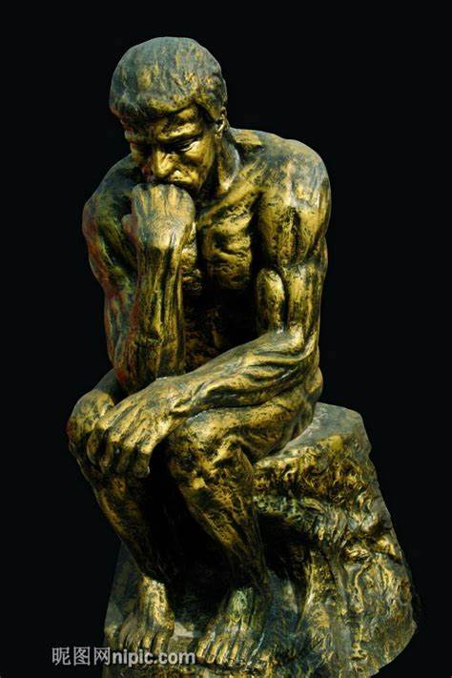
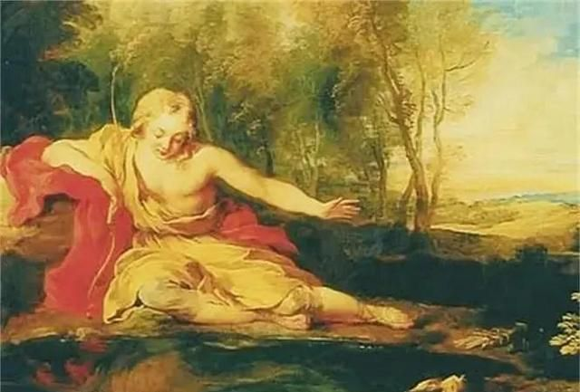
1. reflection n. 沉思；反射；映像；反映
L2:：for quiet periods of reflection can lead to personal improvement
表“沉思”不可数名词
表“（镜子里的）映像，（水里的）倒影；反映”为可数名词
【派生词】
vt. 反映，映出；反射
reflect
on/upon reflection 经过思考
on futher reflection 进一步思考后
a moment's
momentary
reflection 片刻的沉思
When Narcissus looked at himself by the lake, he saw a reflection that enchanted him.
当在Narcissus在湖边看着自己时，他看到了一个令他着迷的倒影。
narcissus n.水仙花 narcissistic adj. 自恋的

Slide 11


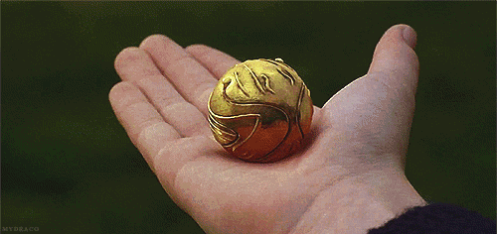
魁地奇比赛中的找球手seeker
2. seek
L3:：when we seek to be alone
在哈利波特的魔法世界中，最受欢迎的运动莫过于魁地奇比赛 (Quidditch)。
找球手seeker在比赛中起着极为重要的作用，他们负责抓取金色飞贼 (the golden snitch)，往往能使自己的球队反败为胜。

Slide 12

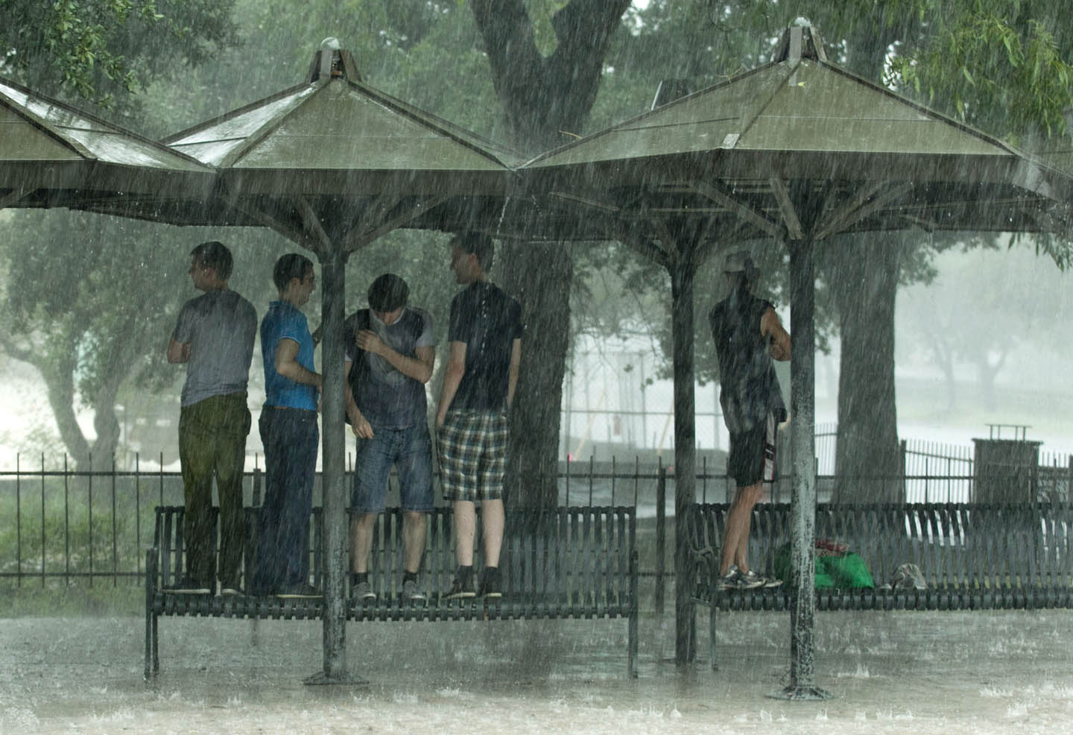

vt & vi 寻找 to look for sb / sth：
2. seek
L3:：when we seek to be alone
seek jobs / work / employment
寻找/寻求……
They sought for a place to shelter from the rain, but in vain.
seek to do sth. 试图做某事
seek sth. from sb. 向某人请求/寻求某物
play hide-and-seek 玩捉迷藏
seek (sought, sought) v [正式用语或书面用语]

Slide 13

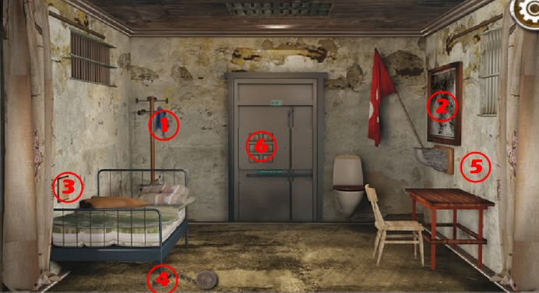
3. escape
L4：we must be careful that we do not always escape into our own world
你玩过密室脱逃 (Room Escape) 吗？试想一下自己被困在一间门被锁上的房间里，在规定的时间内，必须依靠各种细节进行推理，再加上各种道具的配合才能把里面的每一扇门都打开，最终实现“逃”出去。是不是很有意思？这个游戏也恰恰说明了“escape”这个词最核心的意义：(从……) 逃走。

Slide 14
3. escape
L4：we must be careful that we do not always escape into our own world
escape的基本义: (从……) 逃走
escape（逃脱）：脱掉身上的斗篷得以逃脱。
在古代欧洲的战场上，被击败的战士为了保命，往往会使出“金蝉脱壳”的招数，在被敌人抓住斗篷时脱掉斗篷而摆脱敌人，或在被敌人追赶时主动脱掉斗篷，趁敌人去捡斗篷时赶紧逃掉。因为在古代，一件斗篷算是不菲的财产，有钱人才穿得起。
英语单词 escape（逃脱）就跟古人脱掉斗篷保命的做法有关。它来自拉丁语 excappare ，由 ex（out of）+ cappa（cape，斗篷）构成，字面意思就是“脱掉斗篷”。
因此，英语单词 escape 可以按以下方式记忆其拼写：
escape = es （= ex-, out of，脱掉）+ cape（斗篷）。

Slide 15
3. escape vt.&vi.
L4：we must be careful that we do not always escape into our own world
1. The hotel guests tried their best to escape from the burning building.
2. You were lucky to escape punishment / being punished.
3. She looks familiar, but her name escapes me.
4. There’s gas escaping somewhere — can you smell it?
逃跑, 逃走
逃避, 避免
被忘掉
泄漏, 逸出

Slide 16
3. escape n.
L4：we must be careful that we do not always escape into our own world
1. The thief jumped into a car and made his escape.
2. There was a rapid escape of gas.
3. He listens to music as an escape from the pressures of work.
逃脱, 逃离
漏出
解脱
a narrow escape 死里逃生

Slide 17
escape 语义网络图
v
从被围困的地方“逃走”
逃走；逃跑
n
逃跑；逃脱；逃避
从抽象的困境中“逃走”
逃避
(从……)
逃走
（基本义）
从记忆中“逃走”
被忘掉
气体 / 液体从容器中“逃走”
(气体、液体等) 泄漏
泄漏；出口

Slide 18
4. smooth out 消除(问题),克服（困难）
L5：close friendships will help smooth out the sometimes rocky road that we are all meant to travel
smooth out difficulties 克服困难
Nancy smoothed out the wrinkles(褶皱) in her son’s shirt.
弄平；使平整
smooth the way/path for sth. 为...铺平道路
smooth sth. over 缓和，调节
Adam decided to ask Lisa out for dinner to smooth things over.
亚当决定邀请丽莎共进晚餐，以缓和矛盾。

Slide 19
含有 out 的短语动词
cut out
watch out
work out
take out
check out
out
die out
find out
make out
put out
burn out
run out
carry out
学习短语动词时，可以根据小品词画思维导图来学习

Slide 20
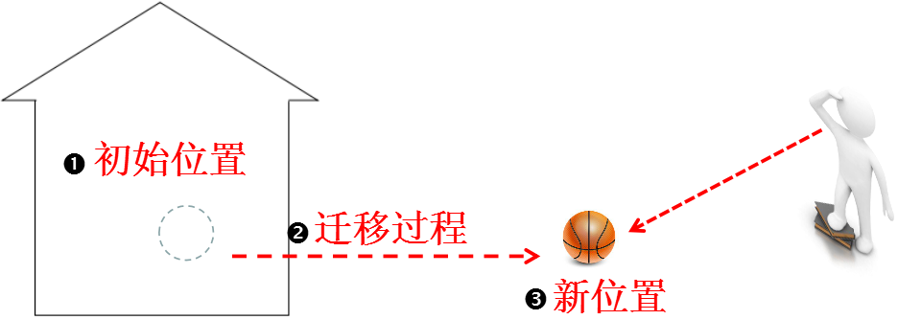


学习含有out的短语动词，还可以从out入手，理解了out的各义项，有助于理解和记忆相关的短语动词。out 的基本义为“出来”。
put out (扑灭)， die out (灭绝)，run out (用完)，burn out (烧尽)
cut out (剪下)，check out
(结账离开) ，find out (发现),
take out (取出)，make out
(看清)
“无；没有”
carry out (执行) ，work out (锻炼),
watch out (当心)
“动态含义”
“可明显看到”

Slide 21
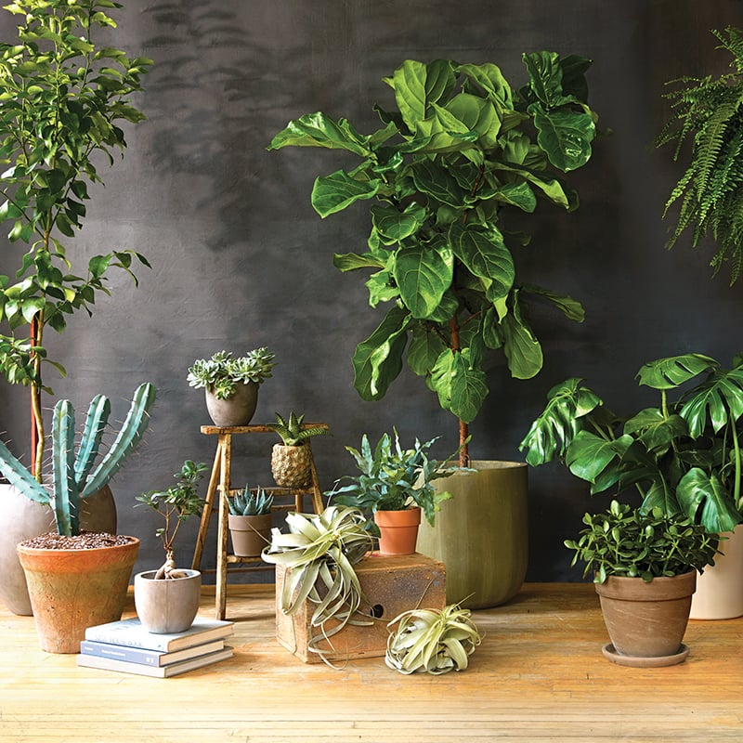
5. benefit
L7：As we live in social groups, there are many benefits of friendship that we can enjoy.
n.  利益；益处 an advantage, improvement, or help that you get from sth:
There are many benefits of indoor plants.
n.  津贴；救济金 (welfare)
be of benefit to 对……有益(be beneficial to)
(be of + 抽象名词 = be + 对应的形容词)
The books are very useful (= are of great use) to English learners.
Friends are very important (= are of great importance) to everyone.
for sb’s benefit / for the benefit of sb 为了某人的利益

Slide 22
5. benefit
L7：As we live in social groups, there are many benefits of friendship that we can enjoy.
vt & vi 有益于；受益：
The rain will benefit the crops greatly.
这场雨对庄稼大有好处
Today we benefit from countless inventions and innovations.
今天，我们受益于无数的发明和创新。

Slide 23
6. comfort
L9：they may comfort the heart, advise the head and help us achieve the goals we set for ourselves.
vt. 宽慰，抚慰 n. 安慰，舒服
There is plenty of room to lie down and sleep in comfort.
I take / draw comfort from the fact that his friends are there to help him.
It was a comfort to think that there was no rent to pay.
The hotel has all modern comforts.
安逸，舒适
安慰，慰藉
令人感到安慰的人（或事物）
舒适的设施（或条件）

Slide 24
7. recognize
L22：We often find it easier to recognize other people’s weaknesses than our own.
re- (again 再、重新) + cognize (to get to know)
recognize 的词源可追溯到15世纪，意为“know again”，即“认出”。

Slide 25

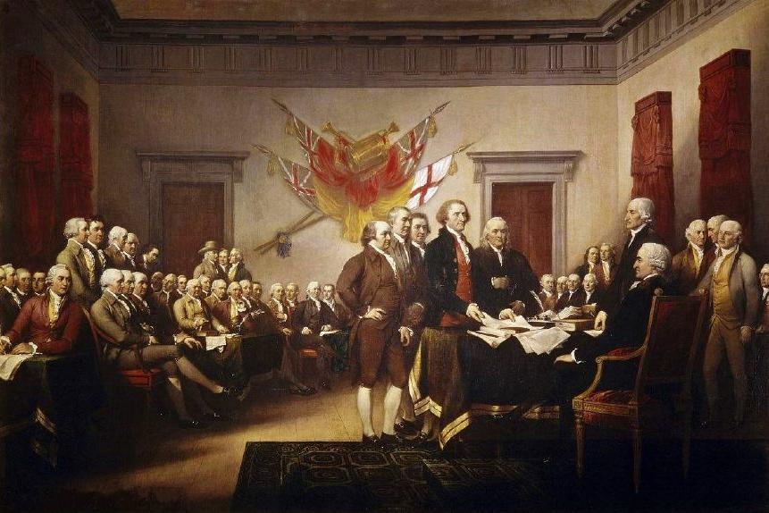
7. recognize
L22：We often find it easier to recognize other people’s weaknesses than our own.
❶ [不用于进行时] 认出；辨认出：
I recognized her by her red hair.
❷ 意识到 to accept or admit that sth is true：(L22 例句)
❸（正式）承认；公认 (acknowledge)：
The British recognized America as an independent state.
❹ 表扬；表彰：
The Canadian National Institute(协会) for the Blind recognized Doris Low for her great contributions.
从/根据某物认出某人
recognize ... as / to be ... 认为…是…

Slide 26
recognize 语义网络图
“认出”人或物
认出；辨认出
内心“认出”或认清事实
意识到
程度递进
认出
（基本义）
“认出”事实并正式接受和
公开
(正式) 承认；公认
“认出”事迹的重要性，并予以公开嘉奖
表扬；表彰

Slide 27

recognition 名词
[U] 认出；识别；承认：
face / speech recognition 人脸/语音识别
The town has changed beyond all recognition since I was last here.
There is general recognition that the study techniques of many students are weak.
变得面目全非/认不出来
人们普遍认为
It is generally recognized that...

Slide 28
1.more often than not
2.smooth out
3.escape into
4.be meant to do sth.
5.generally speaking
6.take on
7.result from
8.in full measure
一般而言，一般说来
由……引起
消除，克服
呈现；具有
最大程度/限度地
通常，多半
注定要做某事
逃入...（逃离现实）

Slide 29
9.depend on
10.seek to do
11.be known as
12.with the help of
13.well-meaning
14.point out
15.put thoughts into words
试图做
依赖，依靠
善意的，好心的
把思想用语言表达
被认为是；作为……而出名
指出
在……的帮助下

Slide 30
seek to be meant to take on well-meaning point out
in many ways thorough smooth out openness escape into
Baker was ____________________ differences with European allies.
I wish to _____________ your misrepresentation of the facts.
We __________ improve relations between our two countries.
Most parents are __________________, but some of them aren't very helpful with their children.
You must see your doctor for a ______________ examination.
As a child he would often _______________ a dreamworld of his own.
This is a way you __________________ go across if you want to get your destination.
Believing he had only a year to live, his writing ___________ a crazy emotion.
Immigrants have contributed to British culture __________________.
Those who got to know him better warmed to his _____________ and honesty.
smoothing out
point out
seek to
well-meaning
thorough
escape into
are meant to
took on
in many ways
openness

Slide 31
1.的确，你可能会发现很难用言语表达出来为什么你会喜欢他们，但你知道你就是喜欢。
Indeed, you might find it hard to put into words exactly why you like them, but you know you do.
2.和朋友谈论烦恼被认为是释放压力的最好方法。
Talking trouble over with your friends is known as the best way to release your stress.
3.在政府和相关政策的帮助下，西部地区的沙漠化得到了全面控制。
With the help of government and relevant policy, the desertification in western part has been controlled in full measure.

Slide 32
4.在我们经历坎坷的时候，我们要学会珍惜每一份幸福。
When we are going through the rocky time, we should learn to treasure every piece of happiness.
5.如果你想要做好英语阅读，积累词汇是你必须要做的几件事中最重要的。
If you want to do well in English reading, vocabulary accumulation is the most important of several things which you are meant to do.
6.我们的建议帮助他们抚平了友情道路上的障碍。
Our advice helped them smooth out the way of friendship.

Slide 33
翻译下面的句子（每空一词）。
阳光对植物有益。
Sunshine is good for plants.
1. Sunshine __________ plants.
2. Plants __________ __________ sunshine.
3. Sunshine __________ __________ __________ plants.
4. Sunshine __________ __________ __________ __________ plants.
benefits
benefit
from
is
beneficial
to
is
of
benefit
to

